Slide 1
Welcome to Presentation
Course code: 0318
Course Title: Software Engineering Lab.
Supervised by:
Khan Md. Hasib
Lecturer,
Department of CSE
State University of Bangladesh
Presented By:
Niaz Ahmed Nayeem
ID. UG02-49-18-003
Batch: 49
Department of CSE
State University of Bangladesh

Slide 2
Project Name: Portfolio

Slide 3
Introduction:
I am creating a portfolio website where my personal life will be described in detail as well as other topics like news, funny videos, pictures etc. will be given as portfolio. Now I have already completed 30% of the work on my website and now I am presenting it below-

Slide 4

Programming Language:
HTML
CSS
JavaScript
PHP
MySQL (Database)

Slide 5
Features:
Home
About me
Resume
Services
Skills
Projects
Blog
Contact

Slide 6
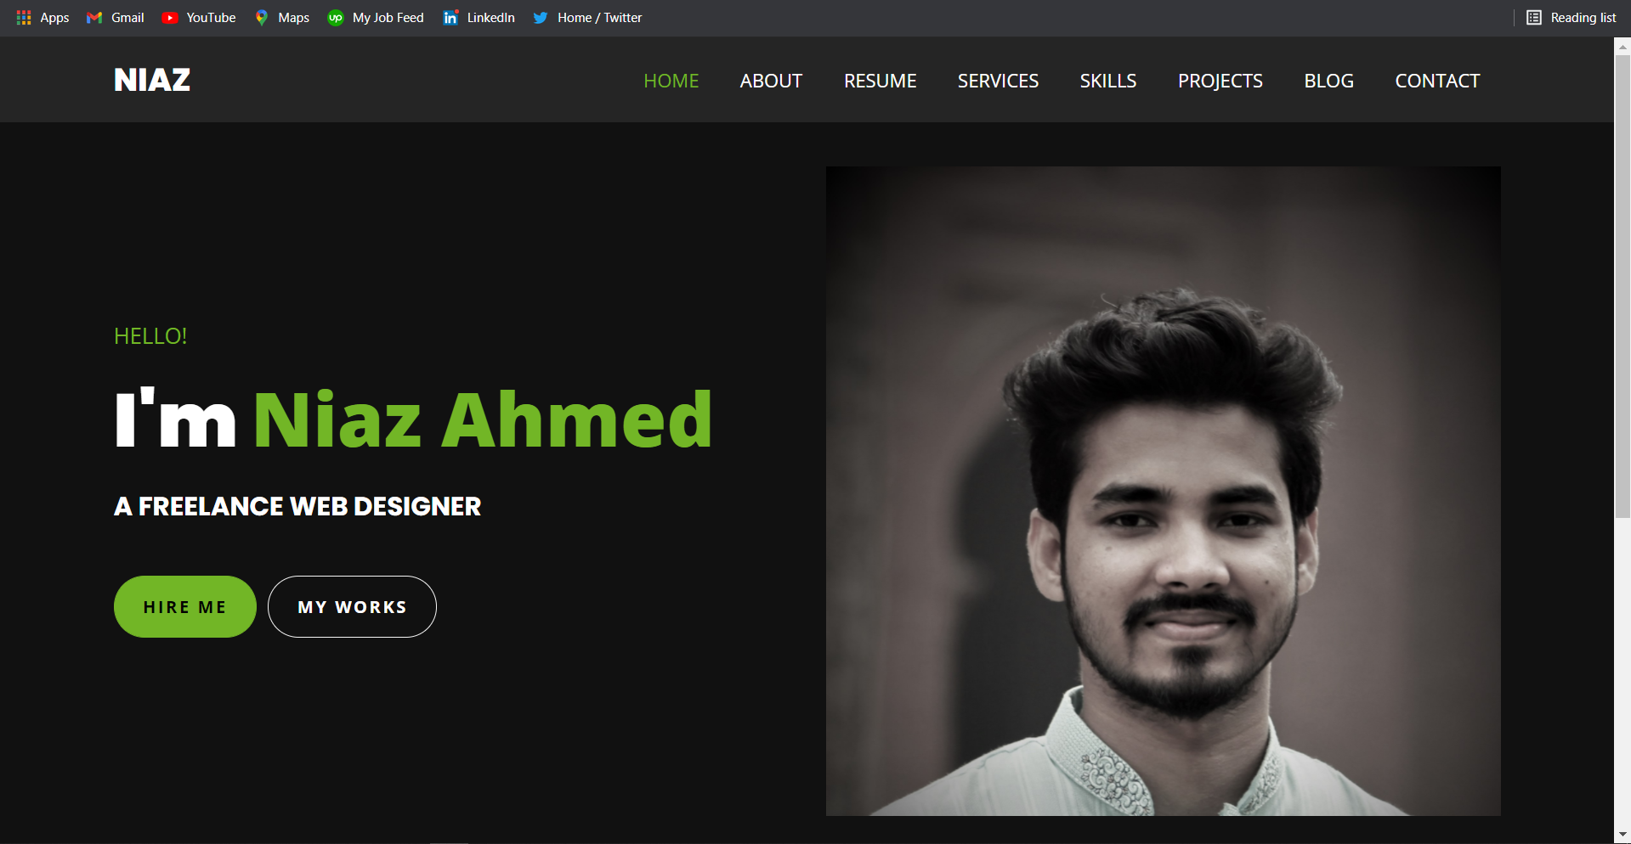
Home Page:

Slide 7
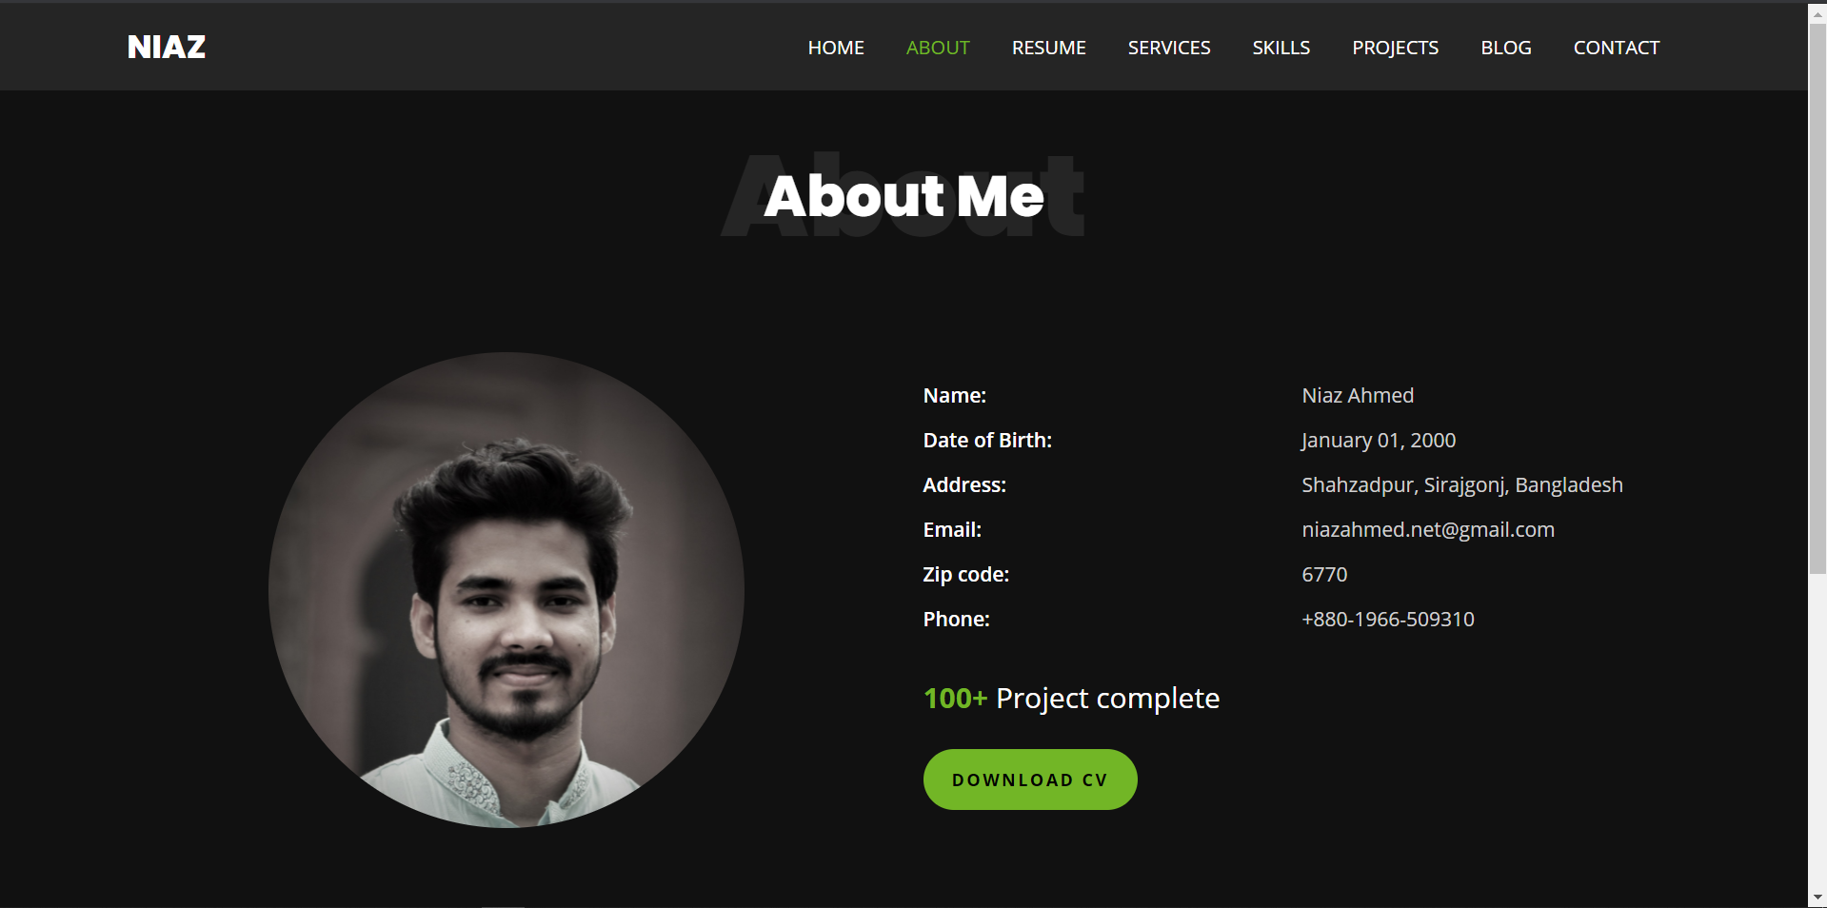
About Page:

Slide 8
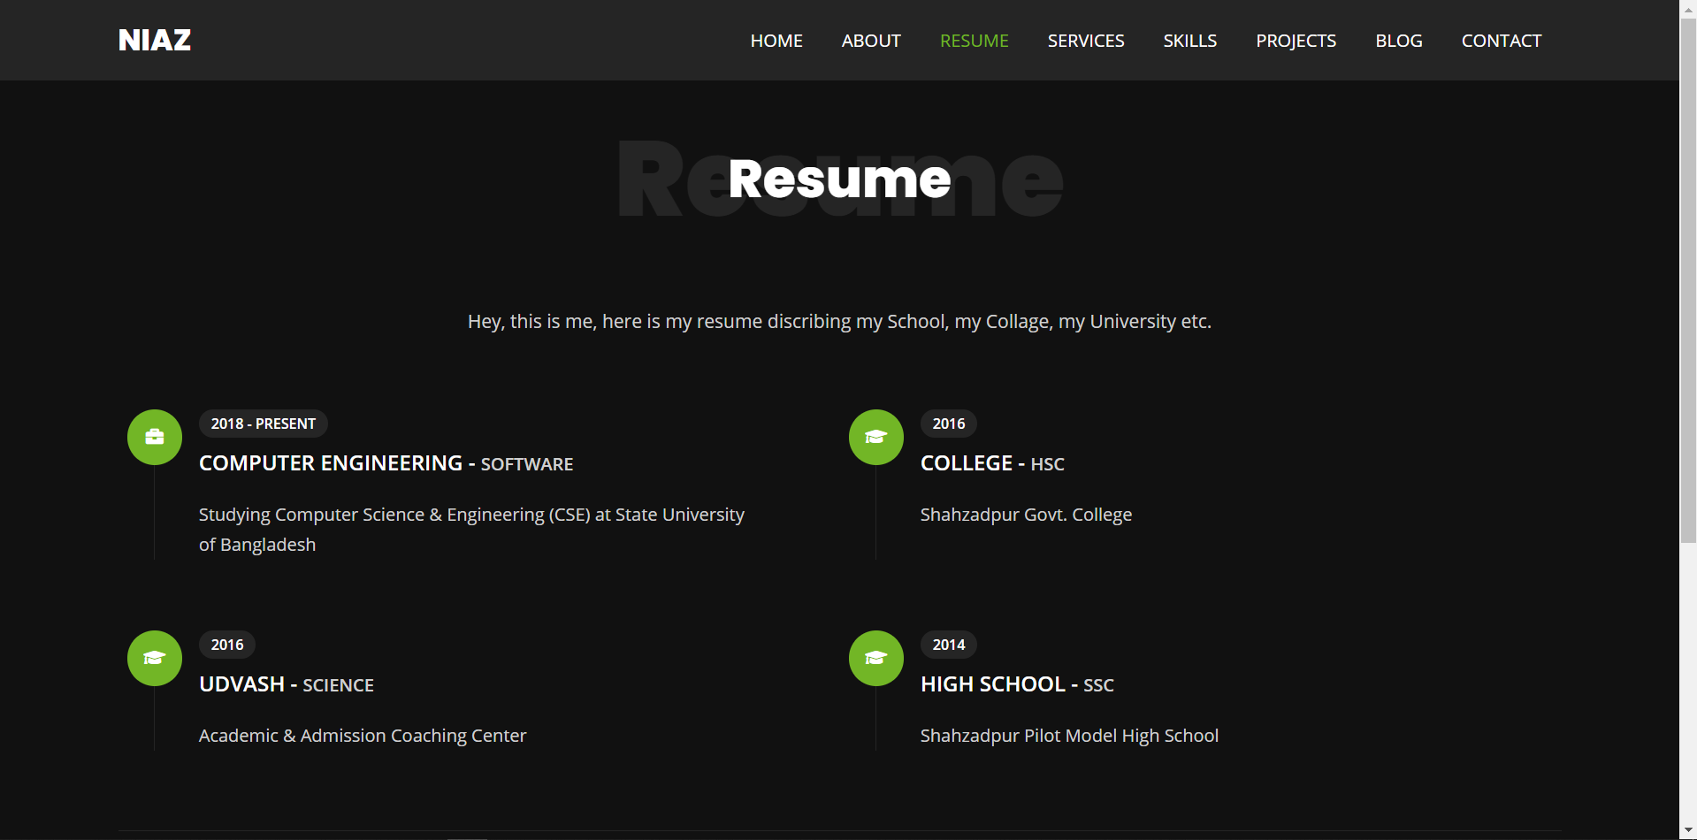
Resume Page:

Slide 9
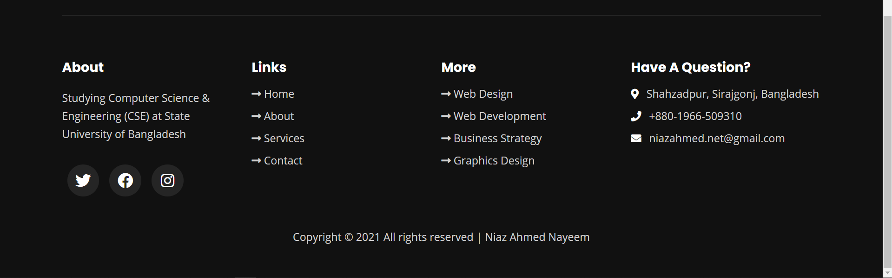
Footer Part:
(For all pages)

Slide 10
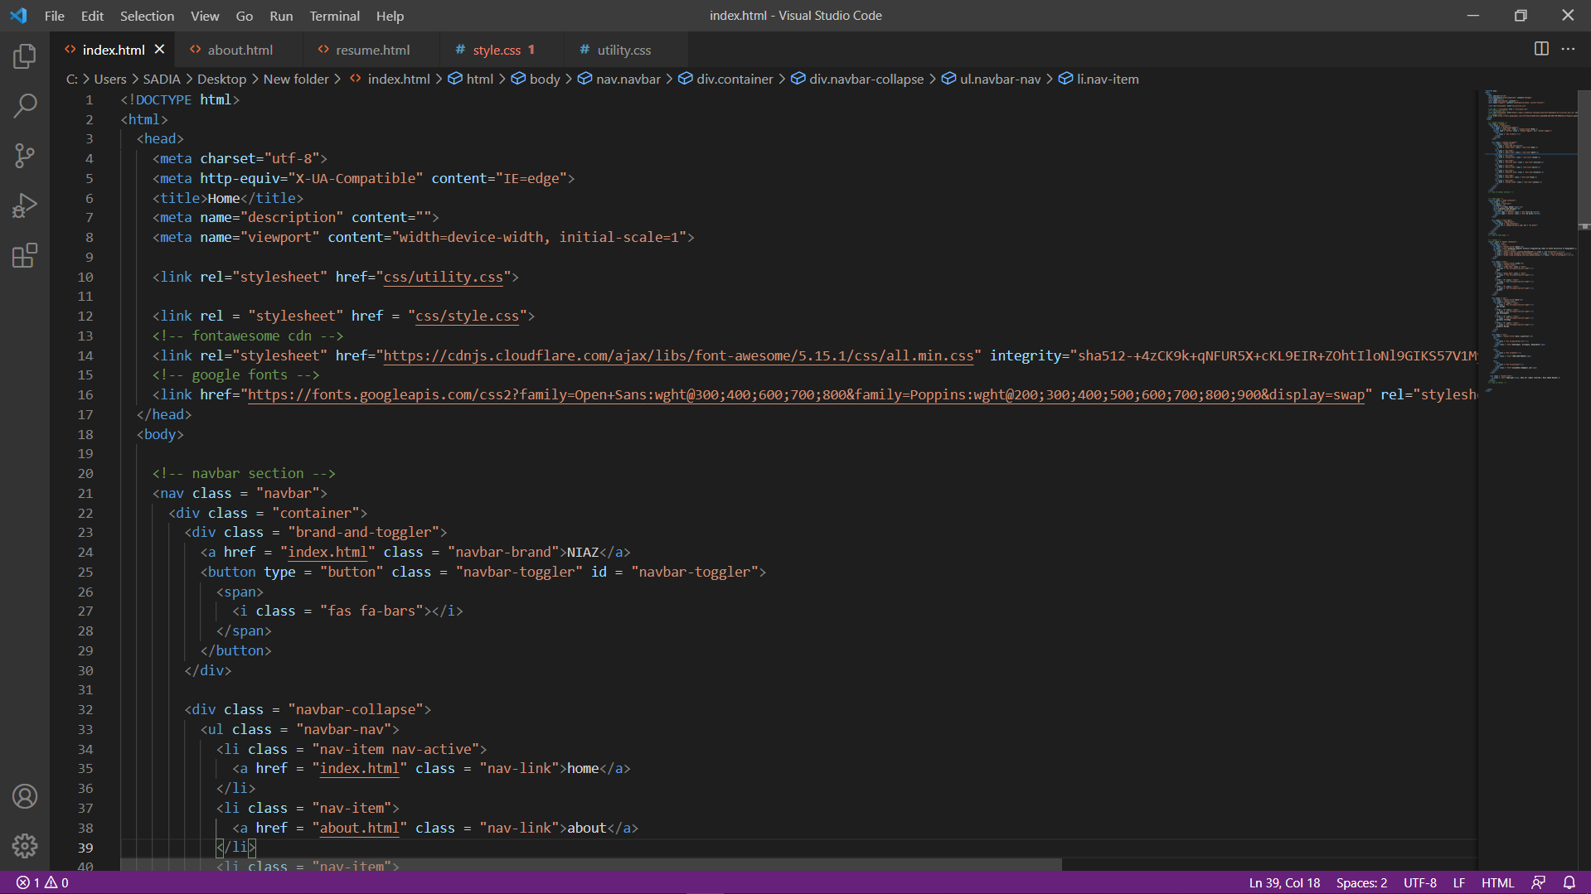
HTML Coding:

Slide 11
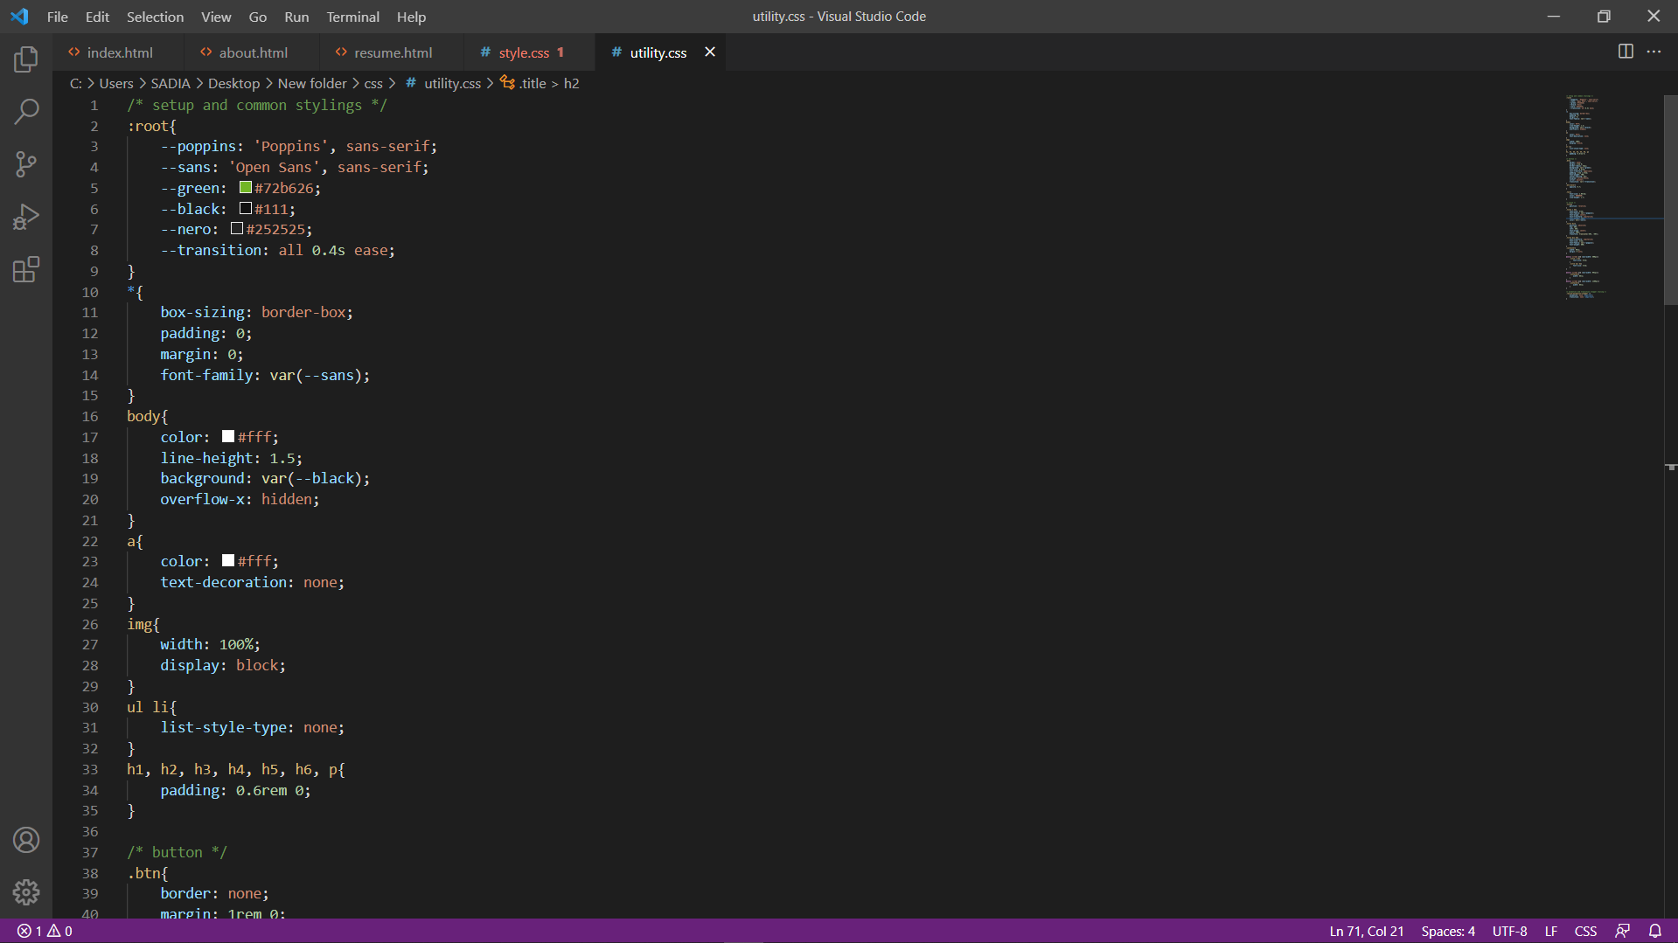
CSS Coding:

Slide 12
Future Plan:
In the future, I will work on (services, skills, projects, blog and contact) pages. I will also use JavaScript and PHP on my website. As a result my website is user friendly.

Slide 13
Thank You…!

